Slide 1
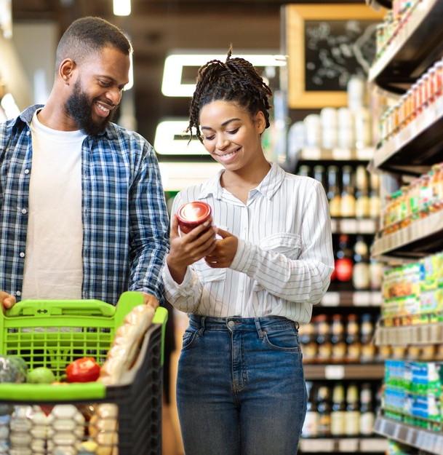
Customer Segmentation Machine Learning II
Dinis Gaspar nº 20221869
Dinis Fernandes nº 20221848
Luís Mendes nº 20221949

Slide 2

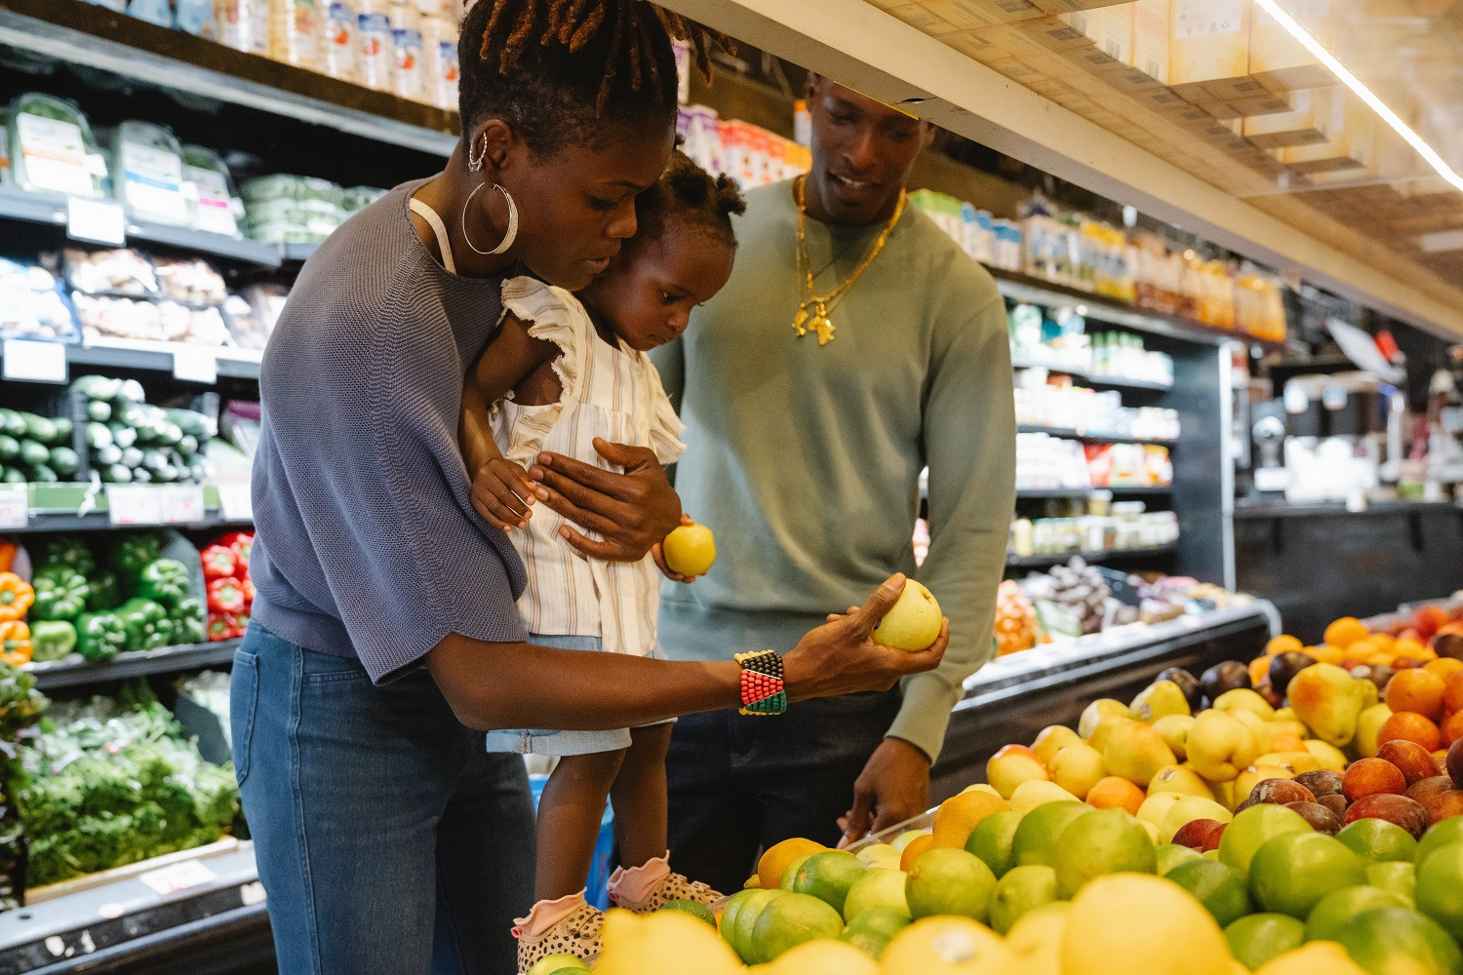

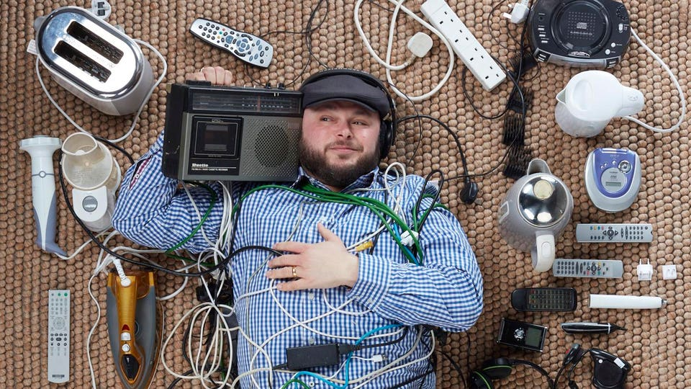
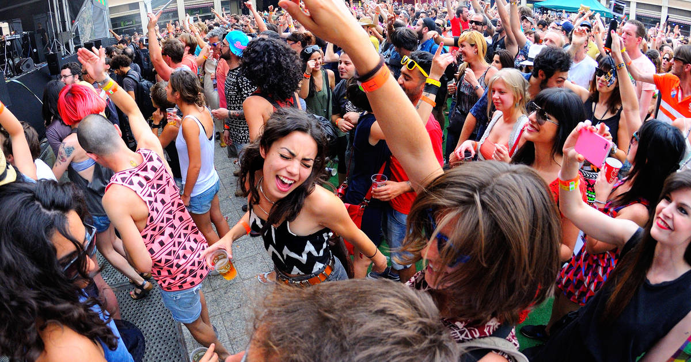
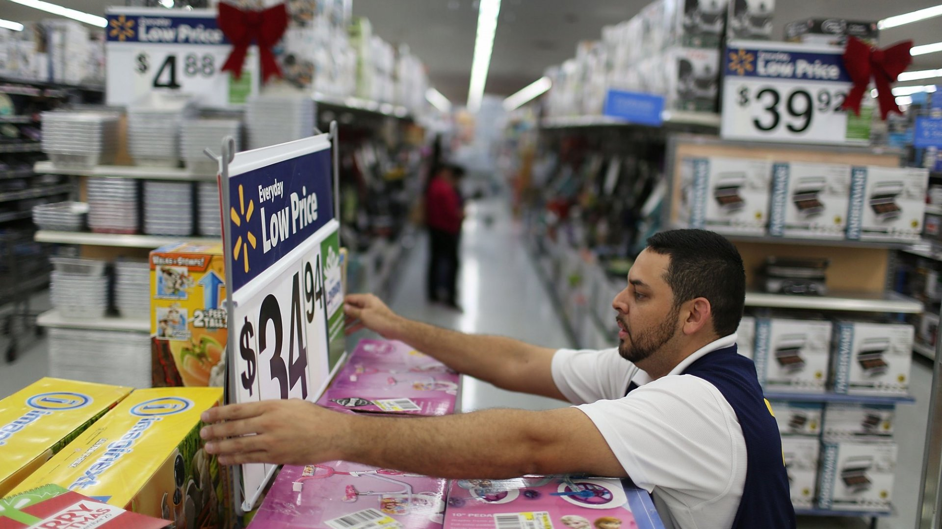
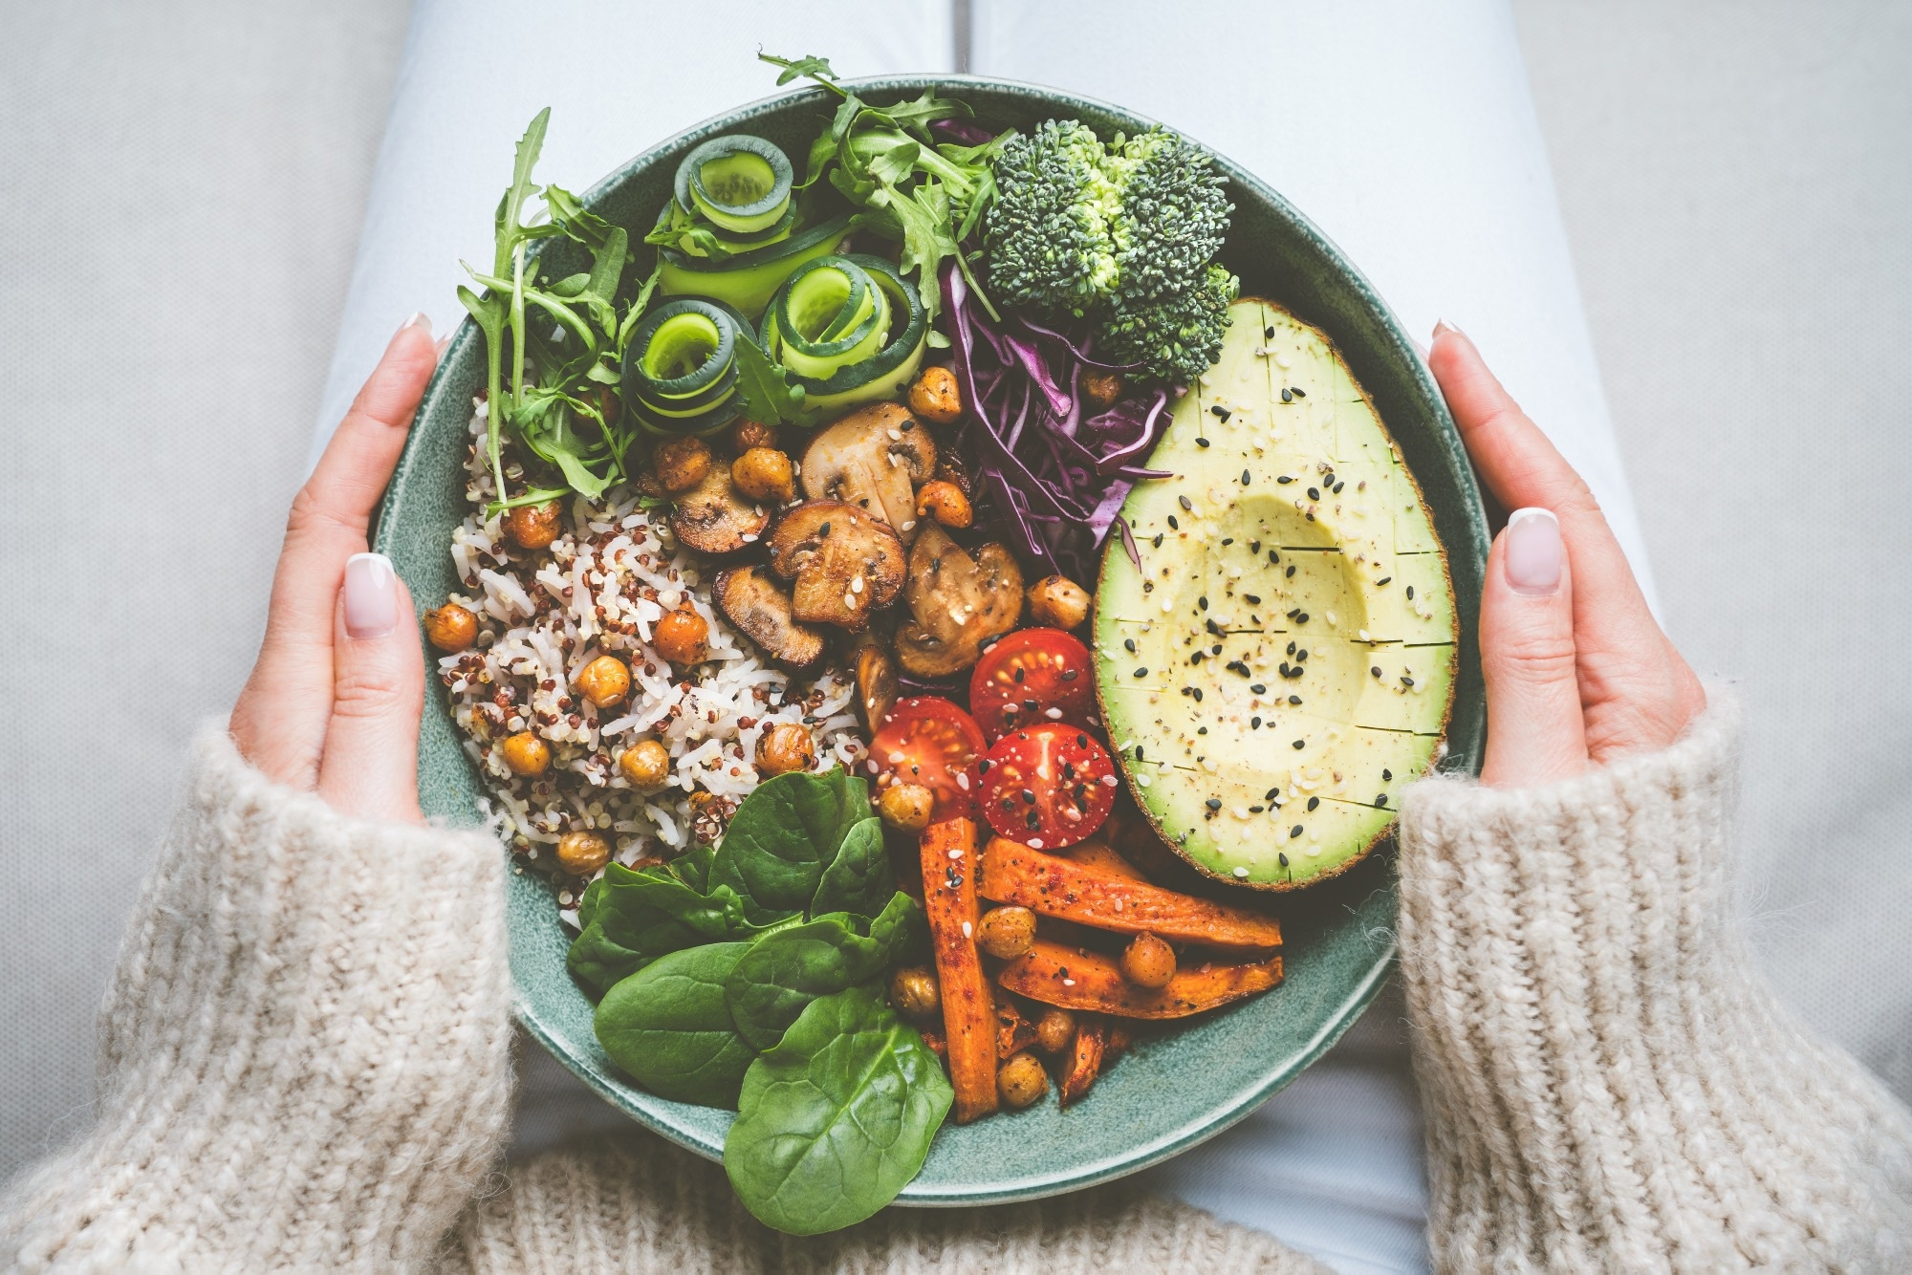
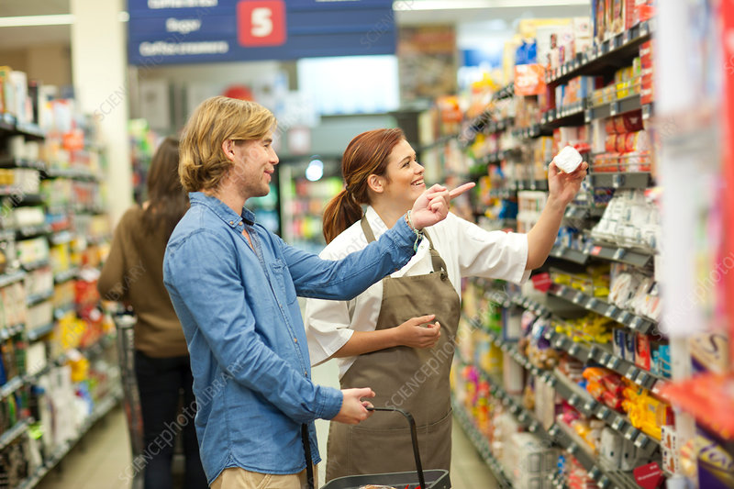

Final Clusters
Pet Lovers
Parents
Young Party People
Fishermen
Young, lots of electronics
Promotions
Loyal Customers
Vegetarians
Gamers

Slide 3
Targeted Promotions
Fishermen
Fish in the morning? Why not? : 10% discount on fish products in purchases before 1pm
One Love Tuna and Salmon: 10% discount of in fresh tuna and salmon if they are bought together
Shrimp Lovers: 5% discount if you bought shrimp
Gamers
Catalogs (digital or physical) about new games, phones or laptops sent to these customers
Lovers Game Night: 50% discount on champagne with a purchase of a laptop, Samsung galaxy or iPhone
No one has to listen your music: 30% discount on Bluetooth headphones if you bought a Samsung galaxy (the same with airpods and an iPhone)
Pet Lovers
Catalogs about toys, homes and food for pets (being generic about the type of pet) sent them to these customers
One Love Human’s Best Friends: 10% discount on pet products on purchases higher than 50€.
Spoil Human’s Best Friend: Buy 2 toys for your pet and get 1 free

Slide 4
Targeted Promotions
Young Party People
For the Thirsty People: 10% discount on alcohol and non-alcohol products on purchases higher than 50€.
“We don’t have money” Alcoholics: 15% discount on beer on the purchase of cider
For that special night: 20% discount on dessert wine and white wine if bought together
Promotions
To encourage higher purchases: 20% of discounts on purchases higher than 100€.
If U love it, we are here for U: Specific 10% discount on a certain product category
Surprise the wife: 20% discount on dessert wine and white wine if bought them together.
Surprise the girlfriend: 15% discount on beer on the purchase of cider (apply the same discount to white wine and dessert wine).
To incentivize the purchase of other candies, put stands with candy bars and gummies near the checkout and the self-checkout.
Parents
One toy is not enough: buy 1 get 1 at 50%.
Separate the oil and cooking oil from the baby food as much as possible, to incentivize them to walk and see more products.
To incentivize the purchase of other candies, put stands with candy bars and gummies near the checkout and the self-checkout.

Slide 5
Targeted Promotions
Vegetarians
One love Vegetables: 10% discount on vegetables products on purchases higher than 30€
Our Special Basket for veggies: 15% discount on melons and mashed potatoes on purchase of 1 Kg (combined) of tomatoes and asparagus.
If U love veggies we are here for U: 10% discount on asparagus, tomatoes, carrots and mashed potatoes.
Young Eletronics People
Separate the oil and cooking oil from the napkins as much as possible, to make them to walk and see more products.
To encourage the purchase of other candies, put stands with candy bars and gummies near the checkout and the self-checkout.
Cakes and Oil: 20% discount on cake if they bought oil (or cooking oil).
One Love Electronics: 10% discount in electronic products on purchases higher than 20€.
Loyal Customers
Separate the oil and cooking oil from the napkins as much as possible, to make them to walk and see more products.
To incentivize the purchase of other candies, put stands with candy bars and gummies near the checkout and the self-checkout.
Soups and Oil:20% discount on soup if they bought oil (or cooking oil).
To the Sweet tooths: 20% discount on candy bars if they bought cake.

